Slide 1

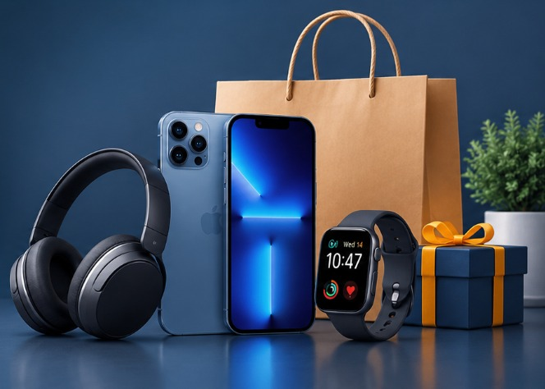
Amazon .clone
Shop Smart. Shop Everything.
A Simple & User-Friendly
E-Commerce Website

Slide 2



VIDYAWATI MUKAND LAL GIRLS COLLEGE, GHAZIABAD
Presentation
ON
AMAZON CLONE
BACHELOR OF COMPUTER APPLICATION
( IIIrd YEAR 5th SEMESTER , 2026-2027)
Submitted by:
Arti
Manya Rana
Submitted to:
Mrs. Neeru Jain

Slide 3
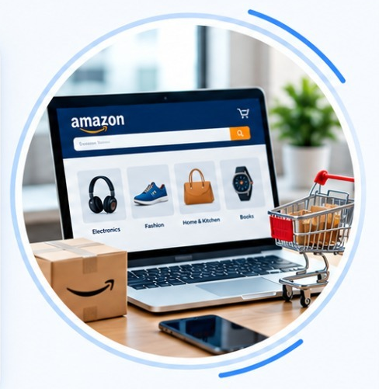
INTRODUCTION
The Amazon Clone is an e-commerce websites that provides an online shopping experience similar to Amazon. It is developed using HTML,CSS, and JavaScript to create a simple responsive, and User-friendly interface. This project helps in understanding the basics of web development and e-commerce apllication.

Slide 4


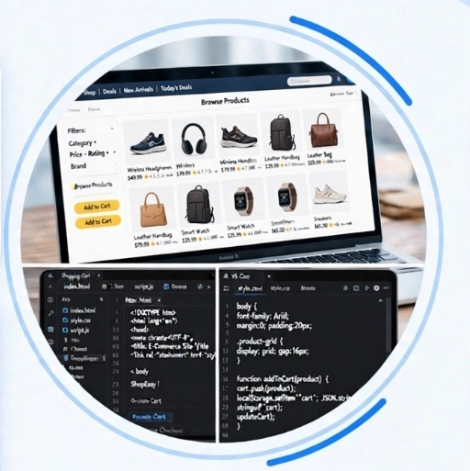


OBJECTIVES
Simple E-Commerce
Website
`
Product Browsing
To develop a simple and user-friendly
E-commerce website similar to Amazon.
To allow users to browse products and view product details easily
Shopping Cart
Web Development
To implement shopping cart funtionally
for adding and managing products.
To understand and apply HTML,CSS and JavaScript in Web development

Slide 5
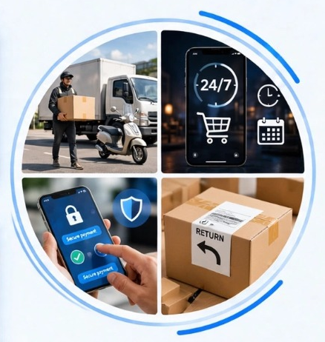
ADVANTAGES
Easy Online Shopping
User-friendly Interface
Shop online from anywhere, anytime.
Simple and easy -to-use website interface for a smooth experiences.
Fast Product Search
Easy Order Placement
Quickly search for the required products with filters and categories.
Add products to the cart and place easily with a few clicks.

Slide 6
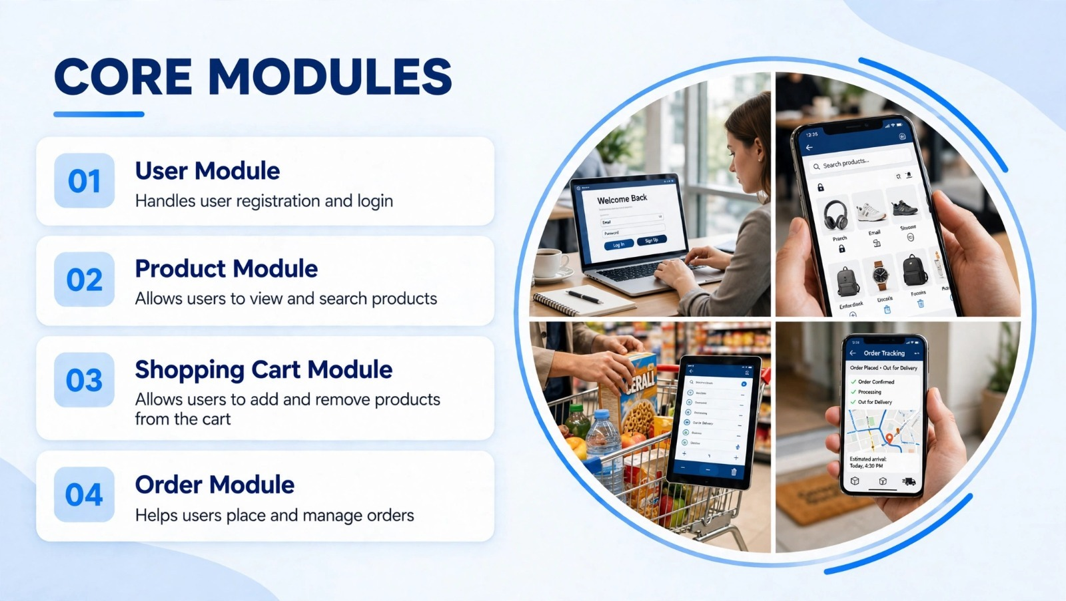
CORE MODULES
User Modules
Product Module
Handles user registration and login.
Allow users to view and search products.
Shopping Cart Module
Order Module
Allow users to add remove products from the cart.
Helps users and manages orders.

Slide 7
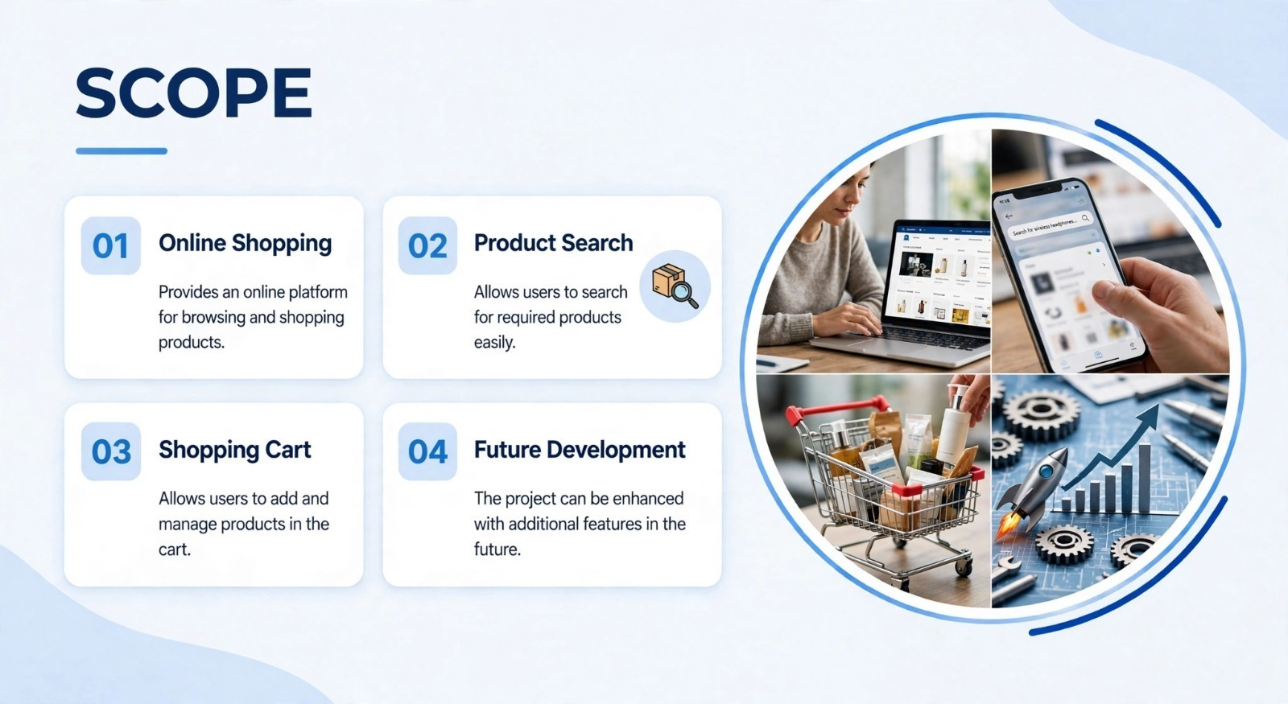
SCOPE
Online Shopping
Product Search
Provides online platform for browsing and shopping products.
Allows users to search for required products easily.
Shopping Cart
Future Development
Allows user to add and manage products in the cart.
The project can be enhanced with additional features in the future.

Slide 8
TECHNICAL DETAILS
Hardware Requirements
Software Requirements
Intel Core i3 or above;
4 GB RAM
Windows 7 or above;
Visual Studio Code;
Live Server
Technologies Used
Key Features
HTML: Creates the structure and pages of the website.
CSS: Provides styling layout and responsive design.
JavaScript: Adds interactivity and dynamic functions such as cart and search .
Add products to cart search products view product details.

Slide 9
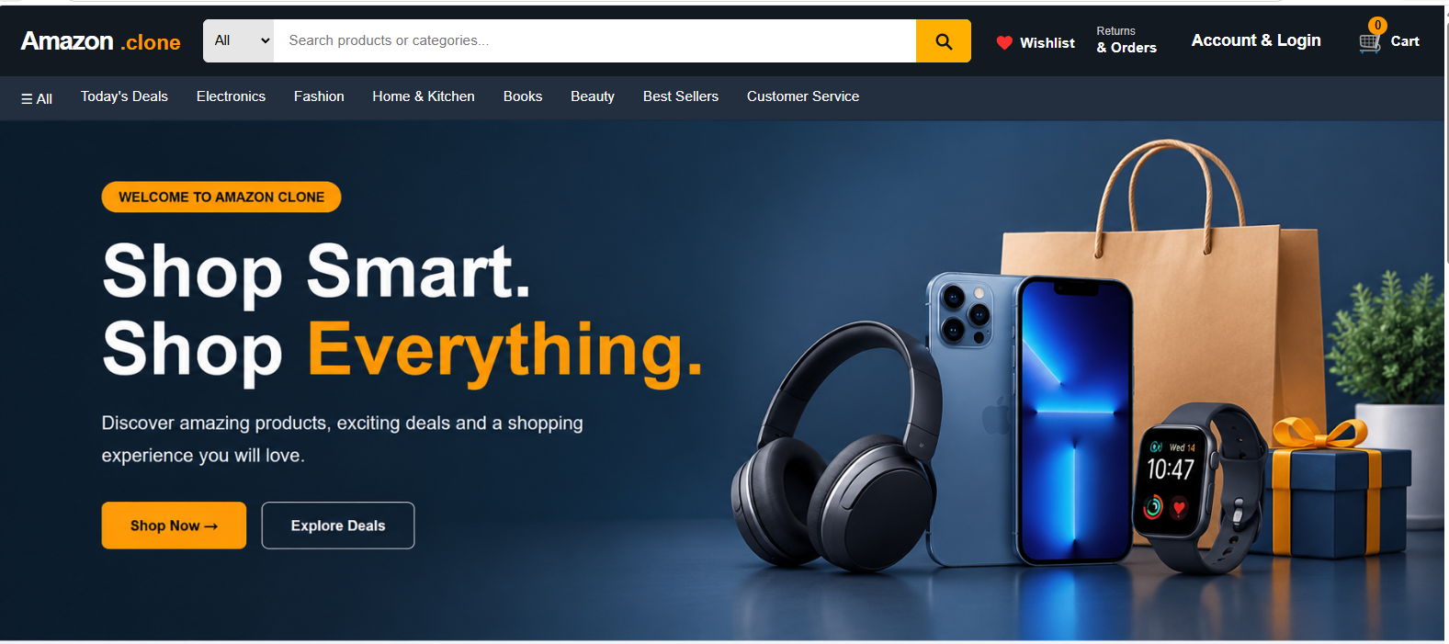
Home page
A simple and user-friendly shopping homepage with
product discovery and navigation.

Slide 10
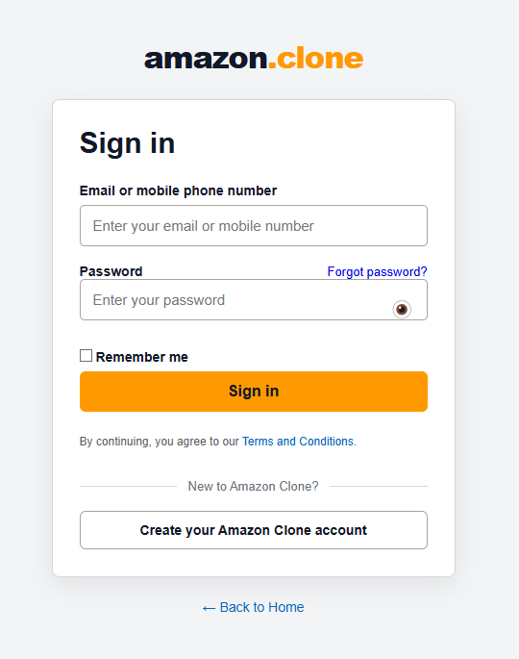
LOGIN PAGE
A simple login interface that allows users to sign in to the
website.

Slide 11
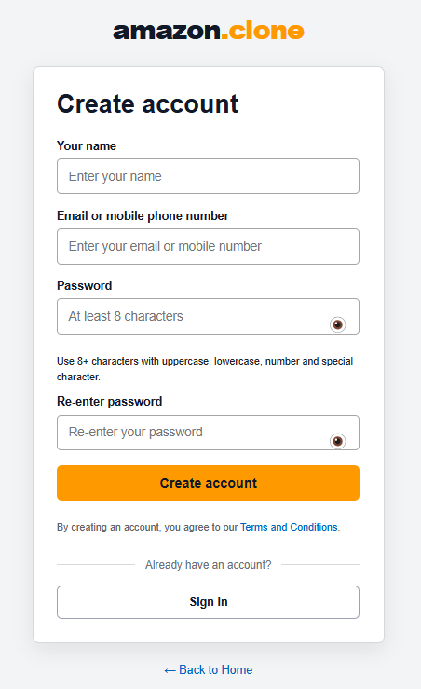
SIGN UP/CREATE ACCOUNT
A simple registration interface for creating a new user account.

Slide 12
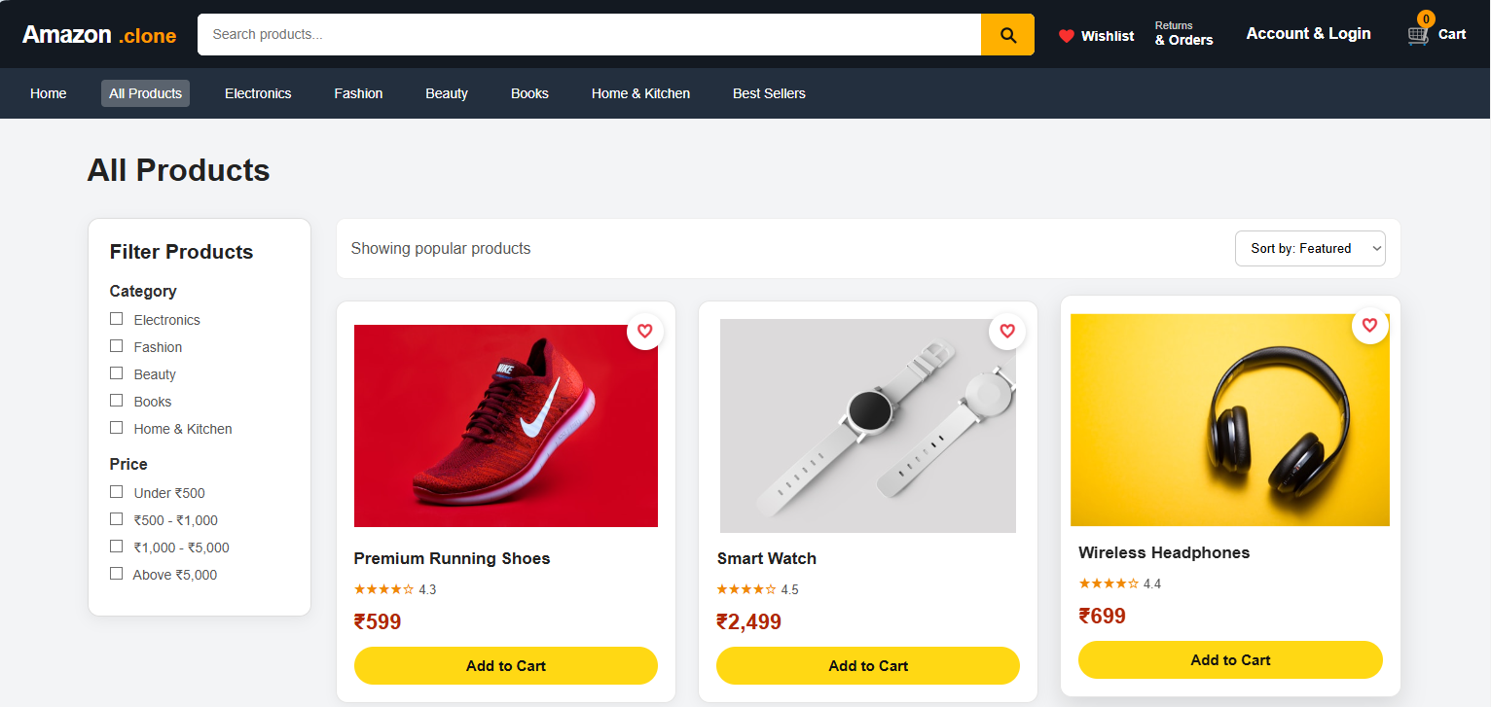
PRODUCT PAGE
A product browsing page that allow users to search, filter and explore products.

Slide 13
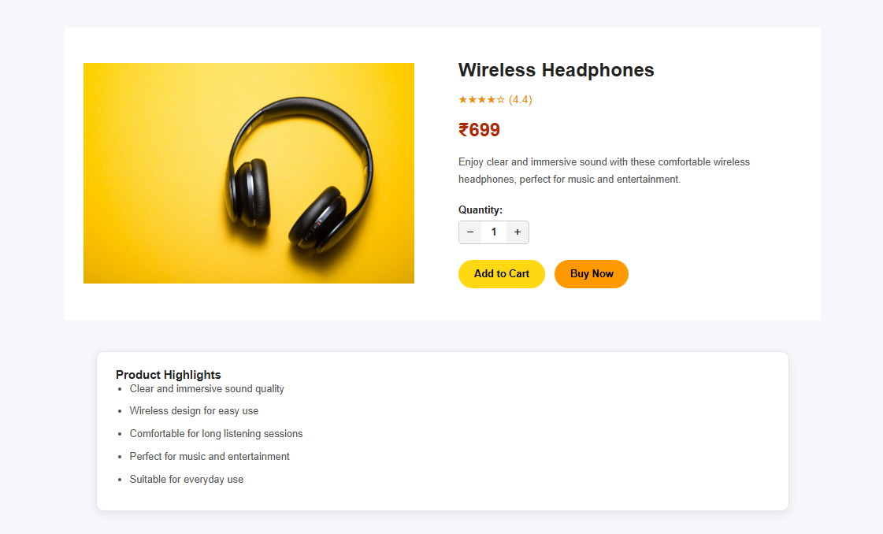
PRODUCT DETAIL PAGE
A product detail ct details page that provides complete information about a selected product.
A product details page that provides complete information about a
selected product .

Slide 14
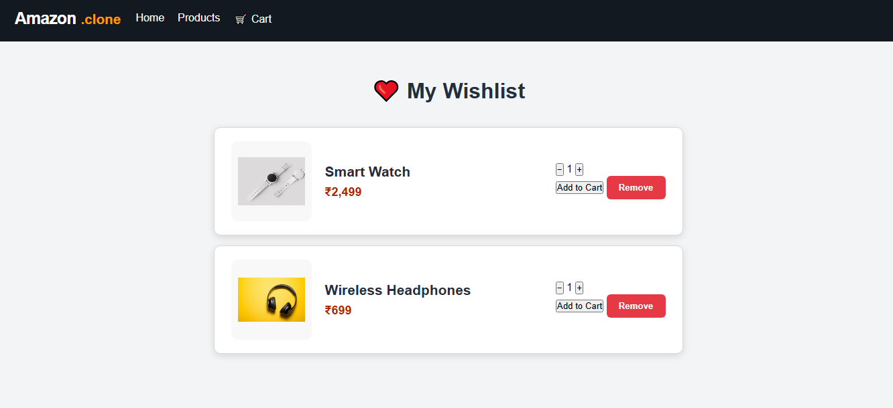
WISHLIST PAGE
A wishlist page where users can view and manage their saved products.

Slide 15
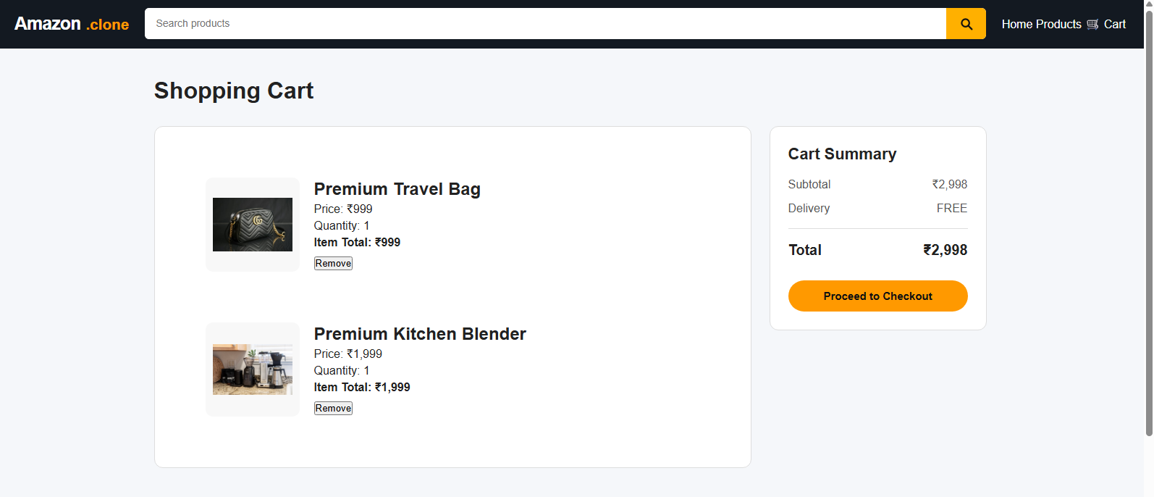
CART PAGE
A shopping cart page where users can review products, manage items and proceed to checkout.

Slide 16
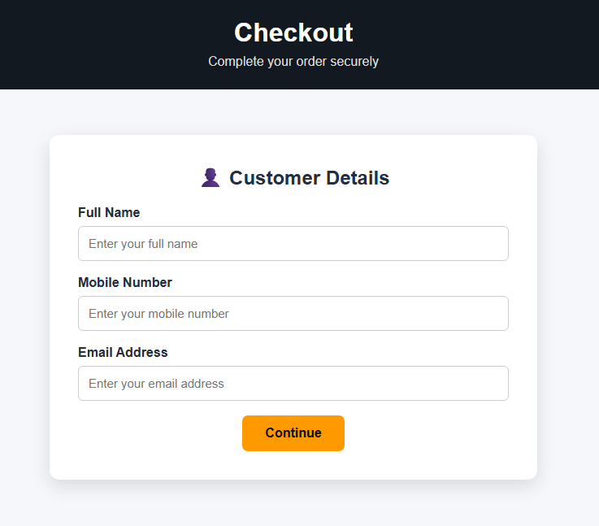
CHECKOUT PAGE
A checkout page that guides users through the final steps of placing an order

Slide 17
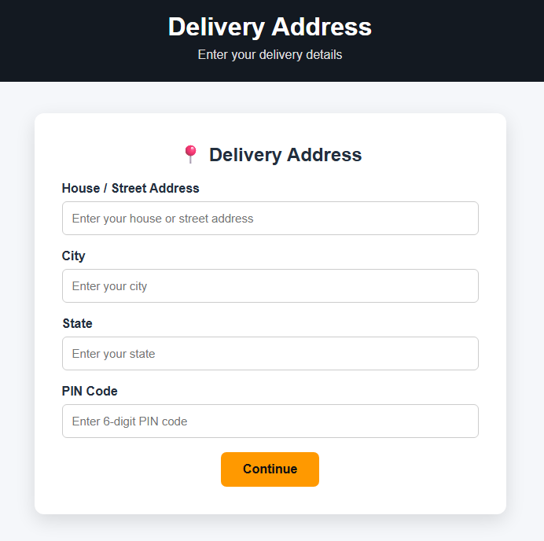
CHECKOUT ADDRESS PAGE
A checkout address page for entering the delivery details required to complete an order.

Slide 18
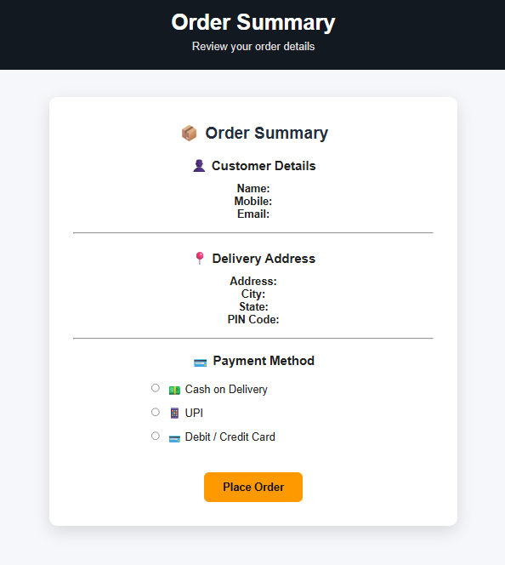
CHECKOUT SUMMARY PAGE
A final order summary page where users can review their order details before confirmation.

Slide 19
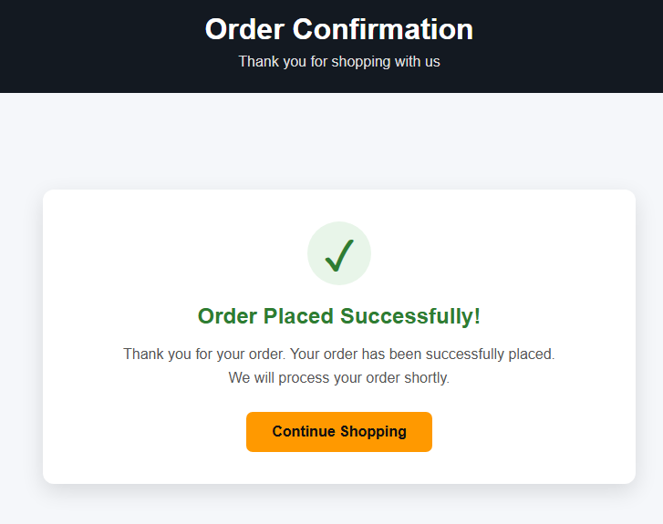
ORDER SUCCESS PAGE
A confirmation page displayed after successfully placing an order.

Slide 20
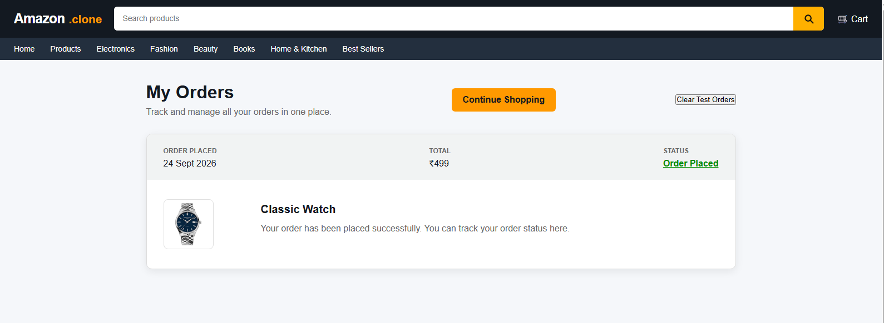
MY ORDERS PAGE
A my orders page where users view their placed orders, order status and available order actions.

Slide 21
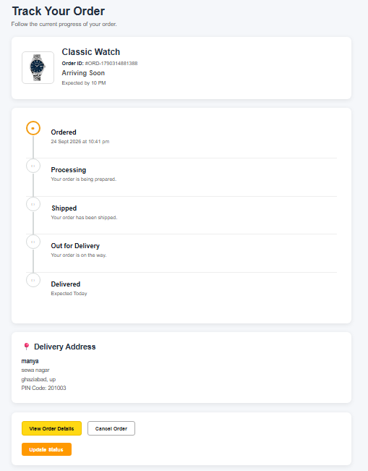
ORDER TRACKING PAGE
A tracking page that shows the different stages of an order from placement to deliver.

Slide 22
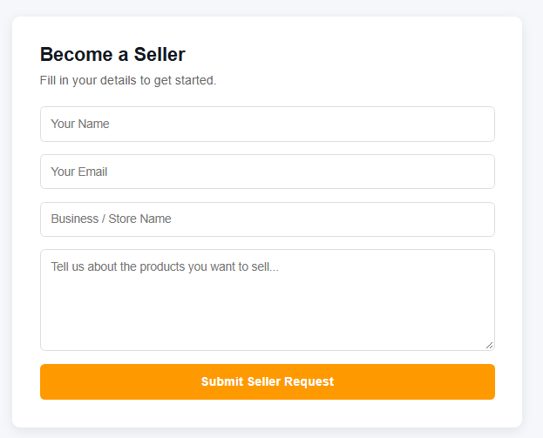
SELL PRODUCT PAGE
A seller section that provides options for listing selling products on the website design

Slide 23
CONCLUSION
Users can browse and search products .
Products can be added and managed in the shopping cart.
Users can view product details and place orders.
The project demonstrates the practical use of basic web development technologies.

Slide 24
TEAM MEMBERS
Arti
Roll-No:- 240962106008
Manya Rana
Roll-No:- 240962106028

Slide 25
THANK YOU
For Your Kind Attention

